Slide 1
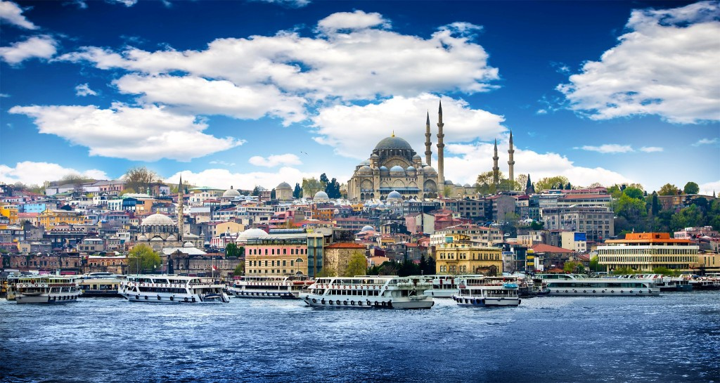
CitEdEV Seminar Meeting İstanbul - 9-10 December 2022

Slide 2
Programme – Friday, 9th December 2022
Time | Activity | Venue
09:15 | Meeting time | In Front of Halı Hotel
09:30 | Meeting time | In Front of Istanbul University Main Gate Family Picture
09:45 – 11:15 | Plenary Session for EC and WGs | Istanbul University Rectorate Building - Doctorate Hall
11:15 – 11:30 | Coffee Break | Lobby
11:30– 12:30 | WG meetings | Istanbul University Rectorate Building - Doctorate Hall
12:30 – 13:45 | Lunch | Istanbul University - Professor’s House
13:50 | Meeting time | In Front of Istanbul University
14:00 – 15:30 | WG meetings | Istanbul University
15:30 – 15:45 | Coffee Break | Istanbul University
15:45 – 18:00 | WG meetings | Istanbul University
19:20 – 23:30 | Social Dinner | Cruise – Turkish Night The Shuttle will be in front of the hotel by 19:30

Slide 3
Programme – Saturday, 10th December 2022
09:30 | Meeting time | In Front of Halı Hotel
09:50 | Meeting time | In Front of Istanbul University Main Gate
10:00 – 11:30 | WG meetings | Istanbul University Kongre ve Kültür Merkezi
11:30 – 11:45 | Coffee Break | Istanbul University Kongre ve Kültür Merkezi
11:45 – 13:00 | WG meetings | Istanbul University Kongre ve Kültür Merkezi
13:00 – 14:00 | Lunch | Istanbul University Kongre ve Kültür Merkezi
14:00 - 16:00 | WG meetings/ presentations | Istanbul University Kongre ve Kültür Merkezi
16:00 – 16:15 | Coffee Break | Istanbul University Kongre ve Kültür Merkezi
16:15 – 16:45 | Plenary Session for EC and WGs | Istanbul University Kongre ve Kültür Merkezi
16:45 – 18:15 | EC meeting | Istanbul University Kongre ve Kültür Merkezi
19:00 – 22:00 | Social Dinner | Faros Restaurant https://www.farosoldcity.com/

Slide 4
WG Nr. | Title | Person in Charge
1 | Knowledge (and Attitutes) of Young People About Civil Society, Citizenship and European Values | Alistair Ross
2 | Conneting Europe: Virtual and Digital Citizenship in Education | Beata Krzywosz-Rynkiewicz
3 | European Values and Teaching Global Responsibility | Jana Stará
4 | Populism and its Impact on Young People | Chris Gifford
5 | Learning from the Past: History, Citizenship, and European Values | Hugo Verkest
6 | Doctoral Students Workshop and Conference | Márta Fülöp
7 | Early Career Academics | Vanja Lozic
8 | Young Citizens on the Margins | Julie Spintkourakis
9 | Tomorrow´s European Leaders: Citizenship Education and Social Action | Andrew Mycock
10 | Citizenship and Education in Times of Social Isolation (Parent´s Role) | Monica Oprescu

Slide 5
WG Nr. | Project Outputs (responsible person Mr. Stan Bohačík)
1 | Case Book, HandBook, Guidelines for Teachers, Publication Activities of members (if applicable)
2 | Case Book, HandBook, Guidelines for Teachers, Publication Activities of members (if applicable)
3 | Case Book, HandBook, Guidelines for Teachers, Publication Activities of members (if applicable)
4 | Case Book, HandBook, Guidelines for Teachers, Publication Activities of members (if applicable)
5 | Case Book, HandBook, Guidelines for Teachers, Publication Activities of members (if applicable)
6 | Case Book, HandBook, Guidelines for Teachers, Publication Activities of members (if applicable)
7
8 | Case Book, HandBook, Guidelines for Teachers, Publication Activities of members (if applicable)
9 | Case Book, HandBook, Guidelines for Teachers, Publication Activities of members (if applicable)
10 | Case Book, HandBook, Guidelines for Teachers, Publication Activities of members (if applicable)

Slide 6
Current state of progress of outputs
(according to Mr. Stan Bohačík's report from December 7, 20022)
PROJECT DELIVERABLES I.
Deliverable 1 Database
Status Not processed yet (CiCea responsible for the Core of Database)
ETD originally 2020, postponed
Short Description
a range of information sources including secondary data, case studies, research outputs, PhDs (in progress, completed)
drawn from Universities and other (national) registers
also research methodology guidelines and concepts
Deliverable 2 Proceedings of Abstracts
Status Processed once (2022), awaiting
ETD related to the Network International Conferences
Short Description
all the abstracts of the conference contributions
published online on the Network’s website
Deliverable 3 Research report of the Network
Status In progress
ETD related to the Network International Conferences
Short Description
results of the research realised within the project described
after evaluation
recommendations for further steps in the area of the research activities

Slide 7
PROJECT DELIVERABLES II.
Deliverable 4 CaseBook
Status Not processed yet
ETD at the end of the project
Short Description
best practice across EU
transnational best practice studies in the field of citizenship education
enhancement of the knowledge of teachers as well as students
available online
Deliverable 5 HandBook
Status Not processed yet
ETD at the end of the project
Short Description
project results-based publication (e-book)
dedicated to general public
presentation of the basic information about Europeanism, active European citizenship, EU and its institutional frame, etc.
enhancement of the knowledge in the field of citizenship education in the context of European values.
Funny way
Deliverable 6 Guidelines for Teachers
Status Not processed yet
ETD at the end of the project
Short Description
implementation of the project research results into the educational practice
efficient tool to present a contemporary cross-country view in the field of citizenship education, European values and their mutual context
suitable for all degrees of education (primary schools, high-schools and universities)
explanation of the substance of concerned topics

Slide 8
RESEARCH ACTIVITIES
Research Activity 1 Basic Research
Status Done by WG 1 – Research
ETD at the beginning of the project
Results
Research report of the Network (yearly, online)
Handbook (at the end of the implemetation, online
Guidelines for teachers (at the end of the implemetation, online)
Publication activity of WG 1 - Research memebers
Research Activity 2 Continuous Research
Status Ongoing
ETD before the end of the project
Results
Proceedings of Abstracts,
Research reports
Case Book of the Best Practice
Handbook
Guidelines for Teachers
Publication activity of WG 1 - Research memebers
International Journal of Citizenship Teaching and Learning
Pedagogika - an educational sciences journal

Slide 9
PROJECT EVENTS
1x Kick-off seminar & core team meeting
INTERNAL – PROJECT MEMBERS ONLY
Status Processed on-line 2021
2x International conference
PUBLIC
Status Processed once F2F – 2022
Not processed yet
2x Core Team Meeting
INTERNAL – PROJECT MEMBERS ONLY
Status Processed on-line 2021 (a.k.a. Atumn Event 2021)
Ongoing F2F – Istanbul 2022
1x Closing Session & International Conference
PUBLIC
Status Not processed yet
3x Spread-off workshop
PUBLIC
Status Processed once F2F – at the conference 2022
Not processed yet
Not processed yet
Steering Committee Meetings
COMMITTEE MEMBERS ONLY
On-line & F2F (associated to the particular events)
Status on-line processed, awaiting
F2F processed, ongoing, awaiting

